Slide 1
Software Evaluation and Costing
Subhash Paudel
MSCSKE, IOE, Pulchowk Campus
subhash@achsnepal.edu.np
Notes:
M.Sc. Computer Engineering, Computer System and Knowledge Engineering

Slide 2
Risk Evaluation
A risk is a potential problem – it might happen and it might not
– Risk concerns future happenings
– Risk involves change in mind, opinion, actions, places, etc.
– Risk involves choice and the uncertainty that choice entails
Two characteristics of risk
Uncertainty – the risk may or may not happen, that is, there are no 100% risks (those, instead, are called constraints)
Loss – the risk becomes a reality and unwanted consequences or losses occur
Every project involves risk.
project risks, which prevent the project from being completed successfully, are different from the business risk that the delivered products are not profitable.
Here we focus on business risk.
Notes:
Project risk discussion a whole topic on next chapter 5

Slide 3
How do we identify and evaluate risk
Risk identification and ranking
Identify risks and quantify it
One approach →construct a project risk matrix with a checklist of possible risks and classifying risks according to their relative importance and likelihood
Risk Importance and likelihood need to be separately assessed – we might be less concerned with something that, although serious, is very unlikely to occur than with something less serious that is almost certain

Slide 4
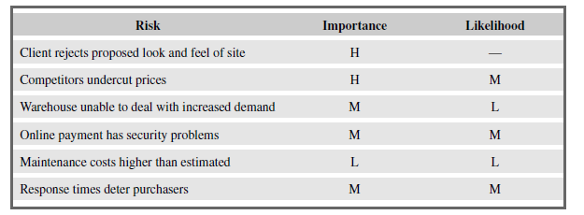
How do we identify and evaluate risk
The project risk matrix may be used as a way of evaluating projects (those with high risks being less favored)
OR
Risk Matrix can also be used as a means of identifying and ranking the risks for a specific project.
Fig → A fragment of a basic project/business risk matrix for an e-commerce application
H → High Risk, M-medium, L-low

Slide 5
Business Risk Evaluation Cost–benefit analysis
An approach to the evaluation of risk is to consider each possible outcome and estimate the probability of its occurring and the corresponding value of the outcome.
Rather than a single cash flow forecast for a project, we will then have a set of cash flow forecasts, each with an associated probability of occurring.
The value of the project is then obtained by summing the cost or benefit for each possible outcome weighted by its corresponding probability.

Slide 6
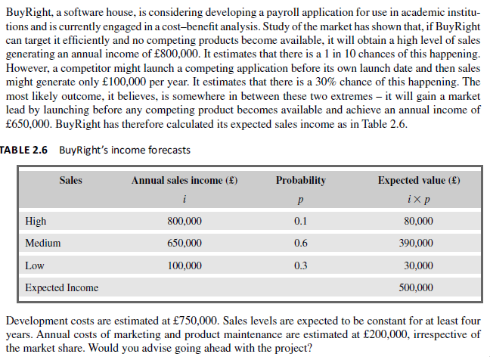

Slide 7
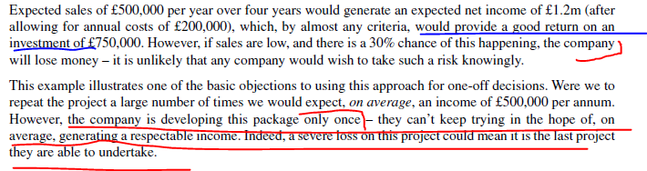

Slide 8
Quantitative Risk analysis
Refers to how the combination of the risks and uncertainties could affect the project.
The goal of this Quantitative analysis is to create a “risk profile” of the project.
You may need to know the following information:
The chance that the project will be completed within a certain period and on budget;
The project's success rate, or the chance that it will be completed; and
The low, average, and high estimates for duration, cost, and other project parameters.

Slide 9
Risk profile analysis→done using sensitivity analysis
In it we vary each of the parameters that affect the project’s cost or benefits
Why do we vary ??? → to know how sensitive the project’s profitability is to each factor.
Sensitivity analysis shows which task variables (Cost, Start and Finish Times, Duration, etc) have the greatest impact on project parameters
We might, for example, vary one of our original estimates by plus or minus 5% and recalculate the expected costs and benefits for the project.
By repeating this exercise for each of our estimates in turn we can evaluate the sensitivity of the project to each factor.
Effect → By studying the results of a sensitivity analysis we can identify those factors that are most important to the success of the project.
We then need to decide whether we can exercise greater control over them or otherwise mitigate their effects.
If neither is the case, then we must live with the risk or abandon the project.

Slide 10
More on Sensitivity Analysis
Sensitivity analysis is the quantitative risk assessment of how changes in a specific model variable impacts the output of the model.
In projects, we are looking at how uncertainties and risks assigned to specific activities correlate with variance in the project.
For example, sensitivity analysis allows you to identify which task’s duration with uncertainty has the strongest correlation with the finish time of the project.
It answers the question, which task inputs have the greatest impact on the key project objectives. This in turn provides clues to where project managers should look first when a management decision is required.

Slide 11
Risk Analysis Approach – Decision Tree
Decision Tree →A technique used to help select best course of action in situations where future actions are uncertain
In many situations its important to be able to assess how a decision will affect the future profitability of the project.

Slide 12
Risk Analysis Approach – Decision Tree
Decision Tree Analysis-Expected Monetary Value Calculation
A successful company is considering when to replace its sales order processing system. The decision largely rests upon the rate at which its business expands – if its market share significantly increases (which it believes will happen if rumors of a competitor’s imminent bankruptcy are fulfilled) the existing system might need to be replaced within two years. Not replacing the system in time could be an expensive option as it could lead to lost revenue if it cannot cope with increased sales. Replacing the system immediately will, however, be expensive as it will mean deferring other projects already scheduled.
Extending the existing system will have an NPV of £75,000, although if the market expands significantly, this will be turned into a loss with an NPV of –£1 00,000 due to lost revenue. If the market does expand, replacing the system now has an NPV of £250,000 due to the benefits of being able to handle increased sales and other benefits such as improved management information. If sales do not increase, however, the benefits will be severely reduced and the project will suffer a loss with an NPV of –£50,000.
The company estimate the likelihood of the market increasing significantly at 20% – and, hence, the probability that it will not increase as 80%.

Slide 13
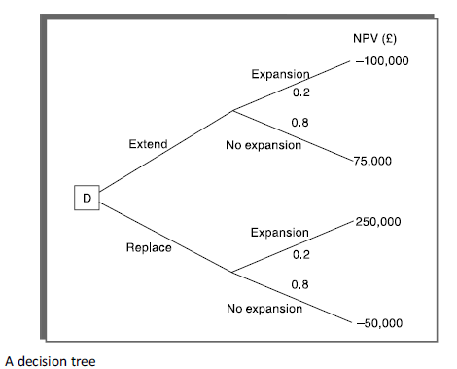
The analysis of a decision tree consists of evaluating the expected benefit of taking each path from a decision point (denoted by D in Figure ).
The expected value of each path is the sum of the value of each possible outcome multiplied by its probability of occurrence. The expected value of extending the system is therefore £40,000 (75,000 * 0.8 – 100,000 * 0.2) and the expected value of replacing the system £10,000 (250,000 * 0.2 – 50,000 * 0.8). The company should therefore choose the option of extending the existing system.

Slide 14
Project approach- Choosing Methodologies and Technologies
Project analysis should select the most appropriate methodologies and technologies for a project.
Methodologies include approaches like Object Oriented (OO) development, the Unified Software Development Process (USDP), Structured Systems Analysis and Design Method (SSADM) and Human-Centred Design,
while technologies might include appropriate application-building and automated testing environments.
Project analysis identifies the methodology, as well as selects the methods within the methodology that are to be deployed.
the chosen methods and technologies will affect:
the training requirements for development staff;
the types of staff to be recruited;
the development environment – both hardware and software;
system maintenance arrangements.
Notes:
USDP-use-case driven, architecture-centric, and iterative and incremental framework of software development

Slide 15
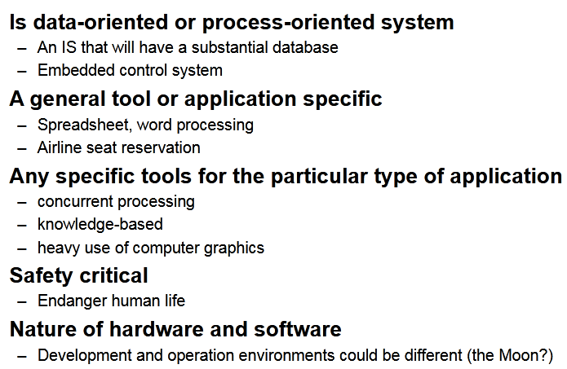
Project Analysis Steps
1. Identify the project as either product driven or objective driven.
A product-driven project creates products that are defined before the start of the project.
In an objective-driven project, a problem is given we want to find the solution and get recommendation
2. Analyze other Project Characteristics The sort of questions that need to be asked

Slide 16
Project approach- Choosing Methodologies and Technologies
3. Identify high-level project risks → where are risks/uncertainty in a project
Identify areas of uncertainty and reduce them
uncertainty can be associated with the products, processes, or resources of a project
3.1 Product uncertainty
How well are the requirements understood?
The users themselves could be uncertain about what a proposed information system is to do.
The government, say, might introduce a new form of taxation but its detailed operation might not be known until case law has been built up.
Some environments change so quickly that a seemingly precise and valid statement of requirements rapidly becomes out of date.

Slide 17
Project approach- Choosing Methodologies and Technologies
3.2 Process uncertainty
The project under consideration might be the first where an organization is using an approach like extreme programming (XP) or a new application-building tool.
Any change in the way that the systems are developed introduces uncertainty.
3.3 Resource uncertainty
The main area of uncertainty here is likely to be the availability of staff of the right ability and experience.
The larger the number of resources needed or the longer the duration of the project, the more inherently risky it will be.
Some factors – such as continually changing requirements – increase uncertainty, while others – for instance, software size – increase complexity. Different strategies are needed to deal with the two distinct types of risks

Slide 18
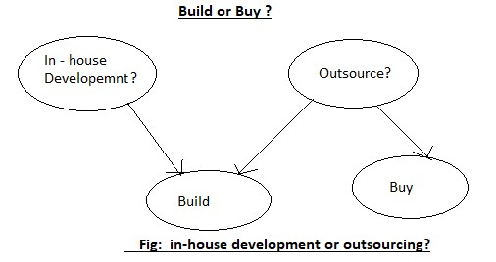
Project approach- Choosing Methodologies and Technologies

Slide 19
Software Process Model
A structured set of activities required to develop a software system.
Many different software processes but all involve:
Specification – defining what the system should do;
Design and implementation – defining the organization of the system and implementing the system;
Validation – checking that it does what the customer wants;
Evolution – changing the system in response to changing customer needs.
A software process model is an abstract representation of a process. It presents a description of a process from some particular perspective.

Slide 20
A short overview of software development process/SDLC
Inception phase goal is to achieve concurrence among stakeholders on the life-cycle objectives for the project.
In inception phase following things happen →
define goals,
scope of project,
business case,
major users and what the system does for them i.e. a simplified use case diagram, and could be architecture of the system,
planning,
Budgeting and costing
Scheduling etc etc

Slide 21
A short overview of software development process/SDLC
From the inception stage, a product undergoes a series of transformations through a few identifiable stages until it is fully developed and released to the customer.
After release, the product is used by the customer and during this time the product needs to be maintained for fixing bugs and enhancing functionalities. This stage is called the maintenance stage.
When the product is no longer useful to the customer, it is retired. This set of identifiable stages through which a product transits from inception to retirement form the life cycle of the product.
The software life cycle is also commonly referred to as Software Development Life Cycle (SDLC) and software process.

Slide 22
A short overview of software development process/SDLC
Software processes are the actions/activities for designing, implementing, and testing a software system
A software process model is an abstraction of the software development process.
The models specify the stages and order of a process.
So, think of software process model as a representation of the order of activities of the process and the sequence in which they are performed.
A model will define the following:
The tasks to be performed
The input and output of each task
The pre and post conditions for each task
The flow and sequence of each task

Slide 23
Your Task/Assignment
Write about Software development lifecycle stages with the input, activities and output and what happens at each stage.
Also describe what each step’s output does to the input of the next process till the end
What is the deliverable in each step with example and describe in short each stage clearly in point

Slide 24
Structured Methods
Structured methods consist of sets of steps and rules which, when applied, generate system products such as use case diagrams.
Each of these products is carefully defined.
Such methods are more time consuming and expensive than more intuitive approaches.

Slide 25
Structured Methods
A structured method includes a design process model, notations to represent the design, report formats, rules and design guidelines.
Structured methods may support some or all of the following models of a system:
An object model that shows the object classes used in the system and their dependencies.
A sequence model that shows how objects in the system interact when the system is executing.
A state transition model that shows system states and the triggers for the transitions from one state to another.
A structural model where the system components and their aggregations are documented.
A data flow model where the system is modelled using the data transformations that take place as it is processed. This is not normally used in object-oriented methods but is still frequently used in real-time and business system design.
A use-case model that shows the interactions between users and the system.

Slide 26
Software Process models→ what they are and when to use which???
There is a specific methodology, which NASA uses to build a space station while the Navy employs a different methodology to build submarines.
Hence, there are different project management methodologies that cater to the needs of different projects spanned across different business domains.

Slide 27
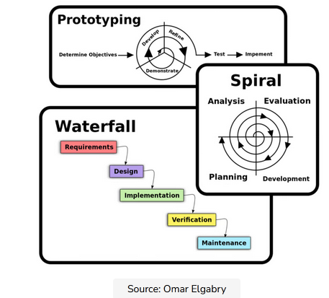
Software Process Models
The goal of a software process model is to provide guidance for controlling and coordinating the tasks to achieve the end product and objectives as effectively as possible.

Slide 28
Software Processes models →Plan driven vs agile processes
Many kinds of process models for meeting different requirements.
Plan-driven processes are processes where all of the process activities are planned in advance and progress is measured against this plan.
Agile processes, planning is incremental and it is easier to change the process to reflect changing customer requirements.
In practice, most practical processes include elements of both plan-driven and agile approaches.
There are no right or wrong software processes.

Slide 29
Software process models
The waterfall model
Plan-driven model. Separate and distinct phases of specification and development.
Incremental development
Specification, development and validation are interleaved. May be plan-driven or agile.
Reuse-oriented software engineering
The system is assembled from existing components. May be plan-driven or agile.
In practice, most large systems are developed using a process that incorporates elements from all of these models.

Slide 30
Software process models/SW project management methodologies
There are separate identified phases in the waterfall model:
Requirements analysis and definition
System and software design
Implementation and unit testing
Integration and system testing
Operation and maintenance
The main drawback of the waterfall model is the difficulty of accommodating change after the process is underway. In principle, a phase has to be complete before moving onto the next phase.
When to Use It: The Waterfall approach is great for manufacturing and construction projects, which are highly structured,
when it’s too expensive to pivot or change anything after the fact.
And where there is uncertainty about how a system is to be implemented, and unfortunately this model is not a choice
The waterfall method makes use of Gantt charts for planning and scheduling
!!! Also see V model the expanded version of waterfall

Slide 31
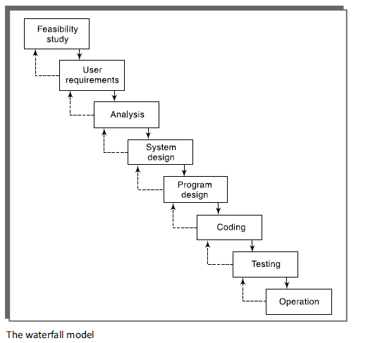
The Waterfall Model

Slide 32
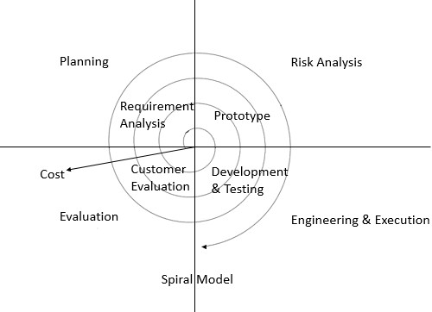
The Spiral Model

Slide 33
The Spiral Model
Process is represented as a spiral rather than as a sequence of activities with backtracking.
Each loop in the spiral represents a phase in the process.
No fixed phases such as specification or design - loops in the spiral are chosen depending on what is required.
Risks are explicitly assessed and resolved throughout the process.
Spiral model has been very influential in helping people think about iteration in software processes and introducing the risk-driven approach to development.
In practice, however, the model is rarely used as published for practical software development.

Slide 34
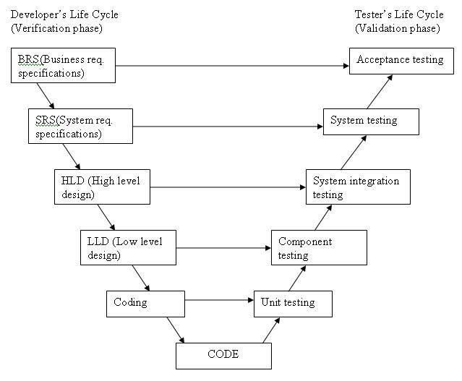
V Process Model
Notes:
Verification and validation model

Slide 35
Iterative Process Model
The iterative process model is the implementation of the software development life cycle in which the initial development is started based on the initial requirements and more features are added to the base software product with the ongoing iterations until the final system is created.

Slide 36
Software Prototype and why
A prototype is a working model of one or more aspects of the projected system.
It is constructed and tested quickly and inexpensively in order to test out assumptions.
Because Uncertainty about a project is usually because of a lack of knowledge about some aspect
So, prototyping is the need to reduce uncertainty by conducting an experiment.
OR
The most important reason for prototyping is a need to learn about an area of uncertainty.
Thus it is essential to identify at the outset what is to be learnt from the prototype.

Slide 37
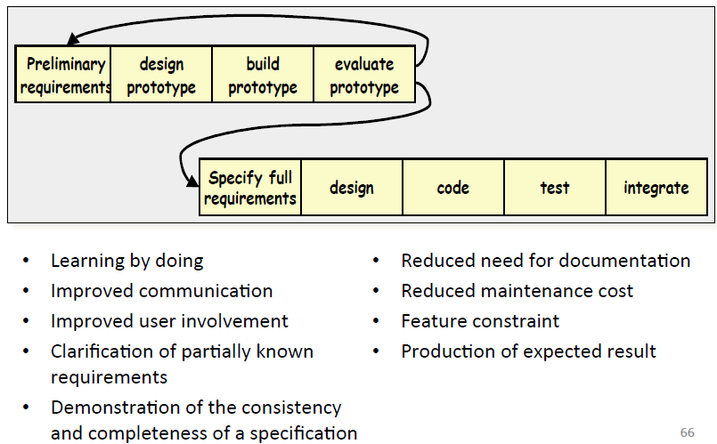
Software Prototype advantages

Slide 38
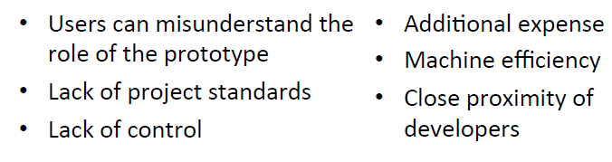
Prototype disadvantages

Slide 39
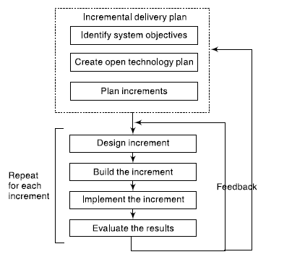
Incremental Delivery
This approach breaks the application down into small components which are then implemented and delivered in sequence.
Each component delivered must give some benefit to the user. Above figure of incremental delivery
Great for projects that have loosely-coupled parts and projects with complete and clear requirements.

Slide 40
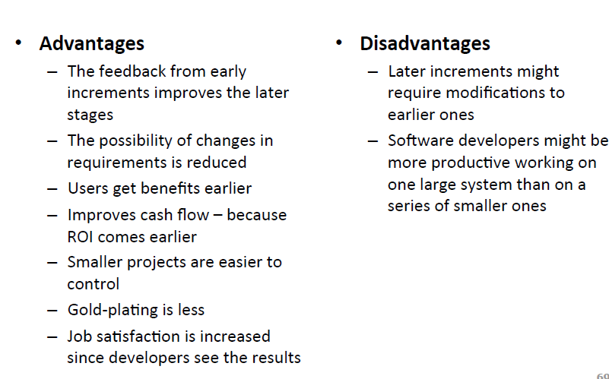
Incremental Delivery

Slide 41
Iterative vs Incremental
Incremental: An incremental approach breaks the software development process down into small, manageable portions known as increments.
Each increment builds on the previous version so that improvements are made step by step.
Iterative: In it software development activities are systematically repeated in cycles known as iterations.
A new version of the software is produced after each iteration until the optimal product is achieved.
Iterative and incremental development models are complementary in nature, which is why they are often used together to boost their efficacy and achieve project deliverables.

Slide 42
Incremental and Iterative working together for agile
Incremental development ensures that developers can make changes early on in the process rather than waiting until the end when the allotted time has run out and the money has been spent.
Iterative development means improvements are made on an ongoing basis, so the end result is likely to be delivered on time and be of higher quality. Iterative sprints can help teams to “deliver a better product, in a faster manner.”

Slide 43
An example of iterative and incremental development in Agile
An example of iterative and incremental development in Agile could be the creation of a new e-commerce website.
Incremental phase →The project would be broken down into smaller increments, such as building a wireframe, uploading products, and creating advertising copy.
Iterative phase →As these incremental steps are unfolding, the software development team would repeat the cycles of prototyping and testing to make improvements to the website with each iteration.

Slide 44
Rapid Application Development (RAD)
Includes features of both the prototyping and the incremental delivery models.
major aims of the RAD model are as follows:
to decrease the time taken and the cost incurred to develop software systems;
And to limit the costs of accommodating change requests by incorporating them as early as possible before large investments have been made on development and testing.
Great for systems that need to be produced in a short time and have known requirements.

Slide 45
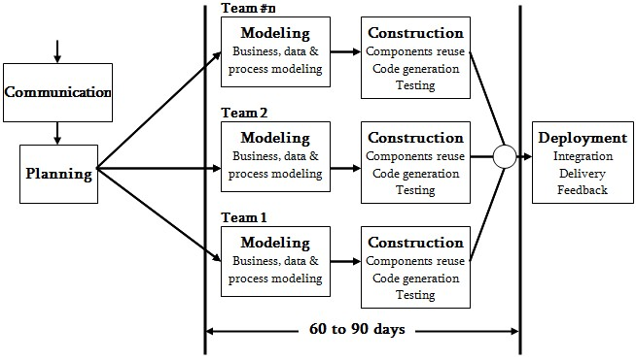
Rapid Application Development (RAD)

Slide 46
Agile Methods—Motivation
Dissatisfaction with the overheads involved in software design methods of the 1980s and 1990s led to the creation of agile methods. These methods:
Focus on the code rather than the design
Are based on an iterative approach to software development
Are intended to deliver working software quickly and evolve this quickly to meet changing requirements.
The aim of agile methods is to
1. reduce overheads in the software process (e.g. by limiting documentation)
2. and to be able to respond quickly to changing requirements without excessive rework.
overhead is any combination of excess or indirect computation time, memory, bandwidth, or other resources that are required to perform a specific task. Overhead can be a deciding factor in software design, with regard to structure, error correction, and feature inclusion

Slide 47
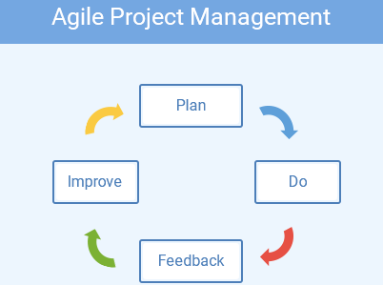

Slide 48
The Agile manifesto
We are uncovering better ways of developing software by doing it and helping others do it. Through this work we have come to value:
Individuals and interactions over processes and tools Working software over comprehensive documentation Customer collaboration over contract negotiation Responding to change over following a plan
That is, while there is value in the items on the right, we value the items on the left more.

Slide 49
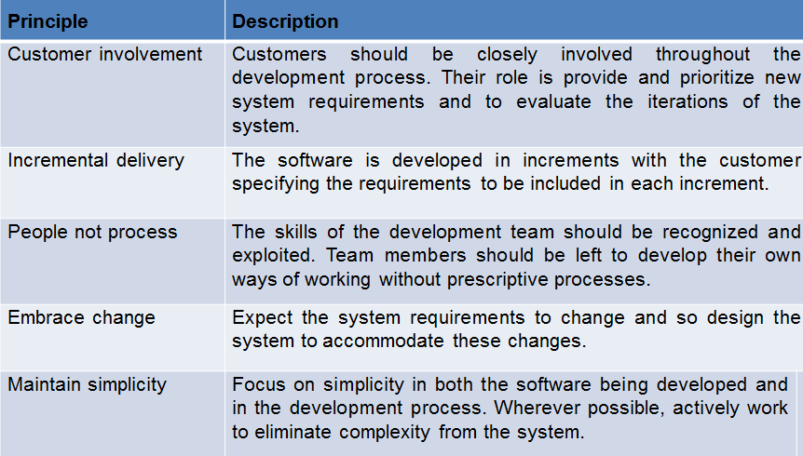
The Principle Of Agile Methods

Slide 50
The Agile Way
The agile process model encourages continuous iterations of development and testing.
Each incremental part is developed over an iteration, and each iteration is designed to be small and manageable so it can be completed within a few weeks.
Each iteration focuses on implementing a small set of features completely.
involves customers in the development process and minimizes documentation by using informal communication.

Slide 51
Agile In summary
In agile project planning and work management are adaptive, evolutionary in development, seeking early delivery and are always open to change if that leads to process improvement.
It’s fast and flexible,
It suggests simultaneous activities (that don’t have any dependencies) can be done in parallel providing two significant benefits over the traditional approaches:
You can quickly detect and fix unexpected issues
You can introduce changes at any stage of the project. Other work processes will change dynamically
Best for: projects that require a responsive and fast-paced approach and involve teams that boast strong communication and collaboration skills.

Slide 52
Agile Types
Some commonly used agile methodologies include:
Scrum: One of the most popular agile models, Scrum consists of iterations called sprints. Each sprint is between 2 to 4 weeks long and is preceded by planning. You cannot make changes after the sprint activities have been defined.
Extreme Programming (XP): a type of agile software development with short development cycles and multiple releases to improve productivity. Customer requirements are sought and can adapt the course of the project.
When requirements change frequently, then you’ll want to use a methodology such as XP. It’s good for when your customer doesn’t have a clear idea of what they want
Kanban: Kanban focuses on visualizations, and if any iterations are used they are kept very short. You use the Kanban Board that has a clear representation of all project activities and their numbers, responsible people, and progress.
Though agile provides a very realistic approach to software development, it isn’t great for complex projects. It can also present challenges during transfers as there is very little documentation. Agile is great for projects with changing requirements.

Slide 53

Selecting the Most Appropriate Process Model
A spiral model is a complex model and is normally deployed for projects in which the risks cannot be anticipated before project execution.
In the given case, a prototyping model would be appropriate for developing the user interface part of the software. (user is unsure so)
For the other parts, a waterfall model would be appropriate assuming that the programmers are experienced in developing similar software products. (their activities are simple so )
Note → there is no rule to just apply single software process in any scenario the thing is you just need to work on thins that makes the software development best ,efficient and simple

